Slide 1

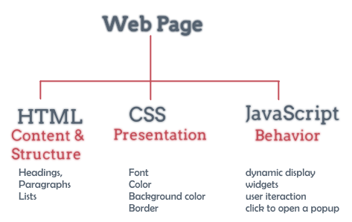
JavaScript Part 2

Slide 2
Lesson Objectives
Mastering string processing rules and techniques
Applies to common objects in JavaScript
Constructing an Object Class in JavaScript

Slide 3
Lesson content
String Handling in JavaScript
Objects in JavaScript
Classes and Objects

Slide 4
String Handling in JavaScript
String handling is very important in every programming language. With JavaScript, a string acts like an object, so there are methods available
Example String declaration:
var txt = "ABCDEFGHIJKLMNOPQRSTUVWXYZ"; var sln = txt.length;
Common functions in string processing:
indexOf | lastIndexOf | search
substring | slice | substr
replace | toUpperCase | toLowerCase
concat | split | charAt

Slide 5
indexOf
Returns the first position found of a substring in the original string
var str = "time and tide wait for no man";
var pos = str.indexOf("an");
➔pos=5

Slide 6
lastIndexOf
Returns the last position found of the substring in the original string
var str = "time and tide wait for no man";
var pos = str. lastIndexOf("an");
➔pos=27

Slide 7
search
Returns the first position found of a substring in the original string
var str = "time and tide wait for no man";
var pos = str.search("an");
➔pos=5
The search function is similar to indexOf but it allows searching by Regular Expression

Slide 8
search
Example case-insensitive search:
var str = "Visit W3Schools"; var n = str.search(/w3schools/i);
➔n=6

Slide 9
substring
Extract substring in original string
var str = "Apple, Banana, Kiwi";
var res = str.substring(7,13);
➔res=“Banana”
var str = "Apple, Banana, Kiwi";
var res = str.substring(7);
➔res=“Banana, Kiwi”

Slide 10
slice
Extract substring in the original string, allowing negative numbers (if the number is negative, count backwards from the end of the string)
var str = "Apple, Banana, Kiwi";
var res = str.slice(7,13);
➔res=“Banana”
var str = "Apple, Banana, Kiwi";
var res = str.slice(-12,-6);
➔res=“Banana”
var str = "Apple, Banana, Kiwi";
var res = str.slice(-12);
➔res=“Banana, Kiwi”
var str = "Apple, Banana, Kiwi";
var res = str.slice(12);
➔res=“a, Kiwi”

Slide 11
substr
Similar to substring, slice. But extracting by the number of characters you want to extract
var str = "Apple, Banana, Kiwi";
var res = str.substr(7,6);
➔res=“Banana”
var str = "Apple, Banana, Kiwi";
var res = str.substring(7,13);
➔res=“Banana”

Slide 12
replace
Replace old string with new string
Example 1:
str = "Please visit Microsoft!"; var str2 = str.replace("Microsoft", "W3Schools");
➔str2= "Please visit W3Schools!"

Slide 13
replace
Replace old string with new string (it can't replace all by itself)
Example 2:
str = "Please visit Microsoft and Microsoft!"; var str2 = str.replace("Microsoft", "W3Schools");
➔str2= "Please visit W3Schools and Microsoft!"

Slide 14
replace
Replace old string with new string (replace all)
Example 3:
str = "Please visit Microsoft and Microsoft!"; var str2 = str.replace(/Microsoft/g, "W3Schools");
➔str2= "Please visit W3Schools and W3Schools!"

Slide 15
replace
Replace old string with new string (case sensitive)
Example 4:
str = "Please visit Microsoft and Microsoft!"; var str2 = str.replace("MICROSOFT", "W3Schools");
➔str2= "Please visit Microsoft and Microsoft!";
str = "Please visit Microsoft and Microsoft!"; var str2 = str.replace(/MICROSOFT/gi, "W3Schools");
➔str2= "Please visit W3Schools and W3Schools!";

Slide 16
toUpperCase
Convert string to Uppercase
var text1 = "Hello World!"; // String var text2 = text1.toUpperCase(); // text2 is text1 converted to upper

Slide 17
toLowerCase
Convert string to lowercase
var text1 = "Hello World!"; // String var text2 = text1.toLowerCase(); // text2 is text1 converted to lower

Slide 18
concat
Used to concatenate 2 or more strings together
var text1 = "Hello" + " " + "World!"; var text2= "Hello".concat(" ", "World!");

Slide 19
split
Split a string into an array of strings according to some criteria
var str = "a,b,c,d,e,f";
var arr = str.split(",");
for(var i=0;i<arr.length;i++)
{
document.writeln(arr[i])
}

Slide 20
charAt
Returns a character at any position in the string
var str = "HELLO WORLD"; str.charAt(0); // returns H

Slide 21
Some data objects
Math object
Date object
Array object

Slide 22
Math object
The Math object has properties and methods that represent advanced mathematical operations.
Math.PI; // returns 3.141592653589793
Math.round(4.7); // returns 5 Math.round(4.4); // returns 4
Math.pow(8, 2); // returns 64
Math.sqrt(64); // returns 8
Math.abs(-4.7); // returns 4.7
Math.ceil(4.4); // returns 5
Math.floor(4.7); // returns 4

Slide 23
Math object
Math.min(0, 150, 30, 20, -8, -200); // returns -200
Math.max(0, 150, 30, 20, -8, -200); // returns 150
Math.sin(90 * Math.PI / 180); // returns 1 (the sine of 90 degrees)
Math.cos(0 * Math.PI / 180); // returns 1 (the cos of 0 degrees)

Slide 24
Date object
Date is a built-in object that holds date and time information.
The Date object has no properties.
The Date object has many methods for setting, retrieving, and processing time information.
Date object stores time in milliseconds since 1/1/1970 00:00:00
DateObject = new Date(parameters);

Slide 25
Date object
Method | Description
getDate() | Returns the day of the month (from 1-31)
getDay() | Returns the day of the week (from 0-6)
getFullYear() | Returns the year (four digits)
getHours() | Returns the hour (from 0-23)
getMilliseconds() | Returns the milliseconds (from 0-999)
getMinutes() | Returns the minutes (from 0-59)
getMonth() | Returns the month (from 0-11)
getSeconds() | Returns the seconds (from 0-59)

Slide 26
Array object
Declaration:
var arr_name = new Array(number of element);
Example:
var weekday=new Array(2);
weekday[0]="Sunday";
weekday[1]="Monday";
var arr2 = [element 1, element 2,…];
- Ví dụ:
var weekday = [“Sunday”, “Monday”];

Slide 27
Array object
Method | Description
indexOf() | Search the array for an element and returns its position
pop() | Removes the last element of an array, and returns that element
push() | Adds new elements to the end of an array, and returns the new length
shift() | Removes the first element of an array, and returns that element
unshift() | Adds new elements to the beginning of an array, and returns the new length

Slide 28
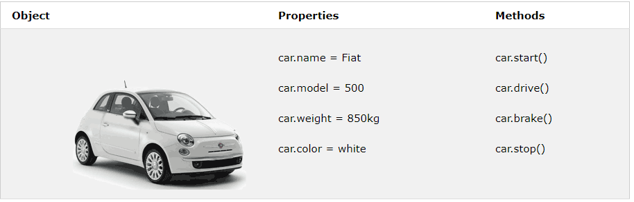
Class and Object
Properties (variables) used to define objects and methods (functions) that affect data are located in the object.
For example, a car is an object. Its attributes are texture, style, and color. Most cars have a few common methods like start(), drive(), brake(), stop().

Slide 29
Class and Object
To access an object's properties, we must specify the object name and its properties:
objectName.propertyName or objectName["propertyName"]
To access an object's method, we must specify the object name and its properties:
objectName.method()

Slide 30
Class and Object
The value of the attribute, which determines the data type
We can declare an object :
name/object variable
var car = {
type:"Fiat",
model:"500",
color:"white"
};
var person = {
firstName:"John",
lastName:"Doe",
age:50,
eyeColor:"blue“
};
Attribute of the object

Slide 31
Class and Object
<body>
<p id="demo"></p>
<script>
var person = {
firstName: "John",
lastName : "Doe",
id : 5566
};
document.getElementById("demo").innerHTML =
person.firstName + " " + person.lastName;
</script>
</body>

Slide 32
Class and Object
We can declare an object with a method :
var person = {
firstName: "John",
lastName : "Doe",
id : 5566,
fullName : function() {
return this.firstName + " " + this.lastName;
}
};
Method name

Slide 33
Class and Object
<body>
<p id="demo"></p>
<script>
var person = {
firstName: "John",
lastName : "Doe",
id : 5566,
fullName : function() {
return this.firstName + " " + this.lastName;
}
};
document.getElementById("demo").innerHTML = person.fullName();
</script>
</body>

Slide 34


Hey! Coding is easy!
END

